Slide 1
Soft Computing Techniques
Unit - 3

Slide 2
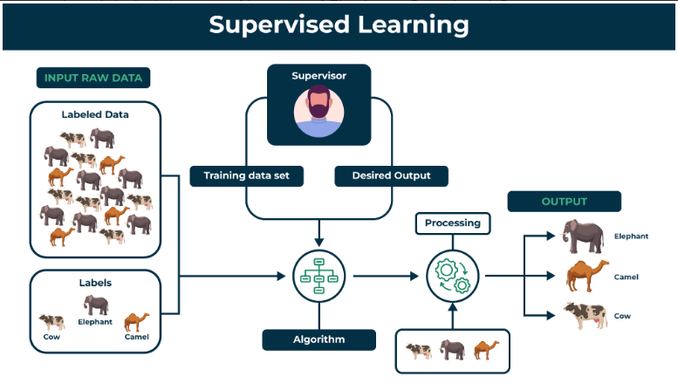
Unsupervised Learning Network
Before going to unsupervised, first lets learn supervised.

Slide 3
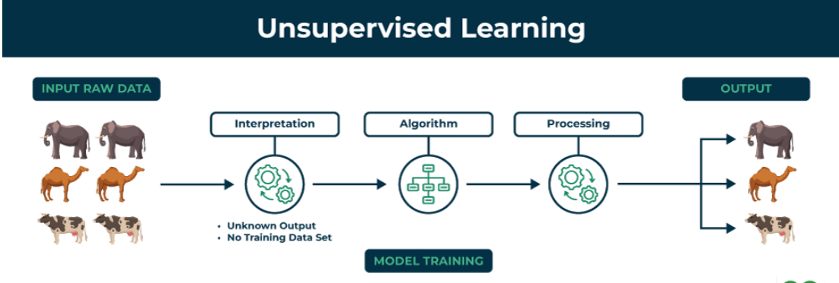

Slide 4
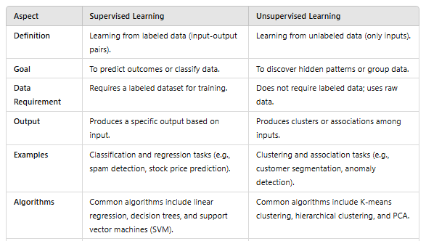
Supervised v/s Unsupervised

Slide 5
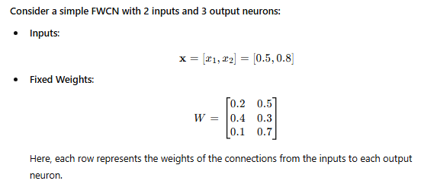
Fixed Weight Competitive Network (FWCN)

Slide 6
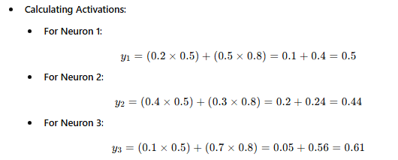
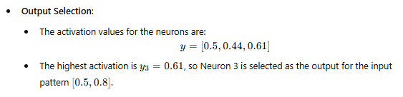
The Fixed Weight Competitive Network efficiently classifies input patterns by activating the neuron with the highest response based on fixed weights.

Slide 7




Kohonen Self-Organizing Feature Maps

Slide 8
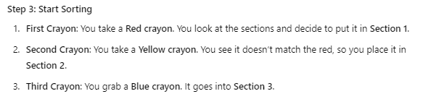



Slide 9
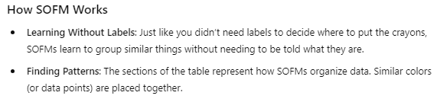


Slide 10
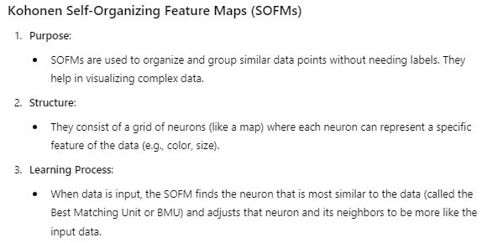
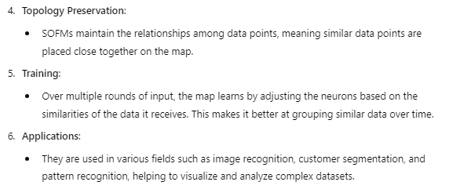

Slide 11
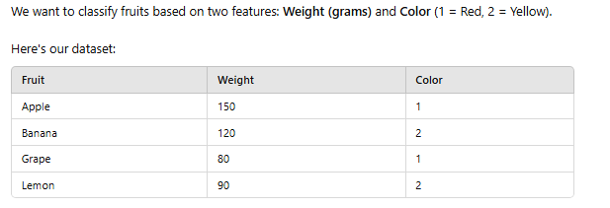
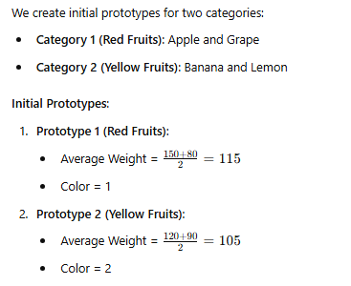
Learning Vector Quantization

Slide 12

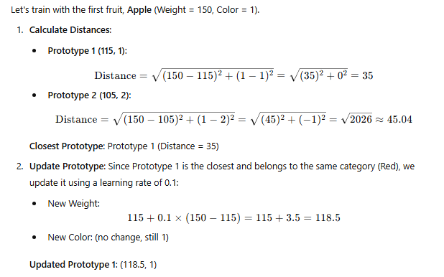

Slide 13
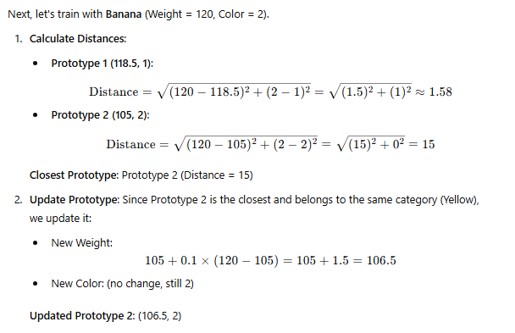


Slide 14
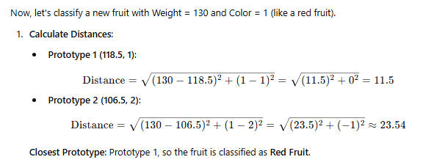
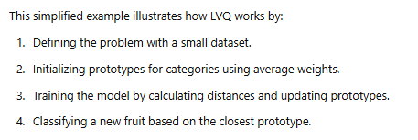

Slide 15
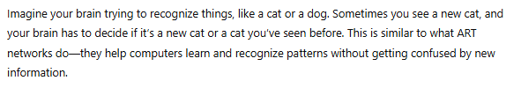
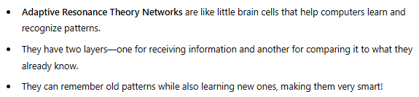
Adaptive Resonance Theory Networks

Slide 16
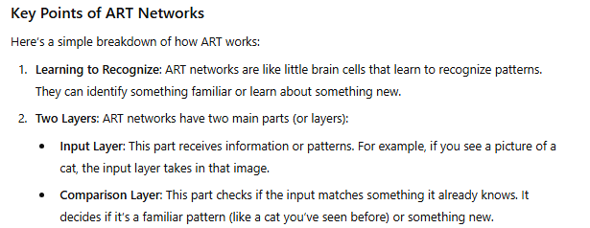
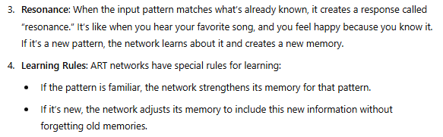

Slide 17
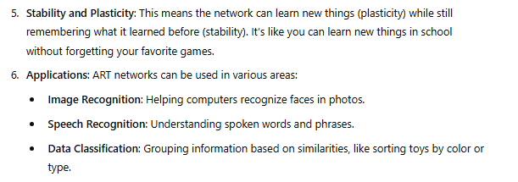
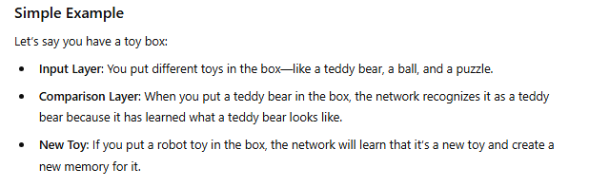

Slide 18
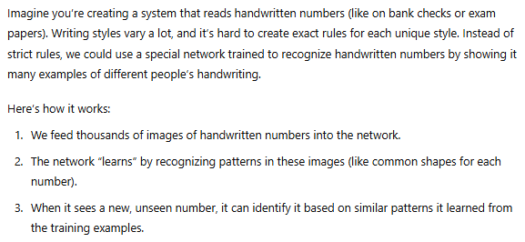
Special Networks
Imagine teaching a friend how to recognize different emotions based on facial expressions. You wouldn’t give them exact measurements but would let them watch and learn by example. Similarly, a special network learns by observing patterns and adjusts itself over time, making it great for soft computing, which aims to mimic human-like decision-making.

Slide 19
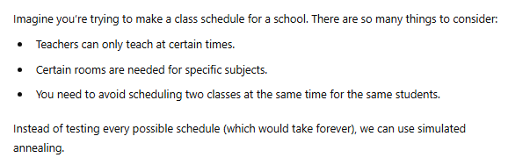
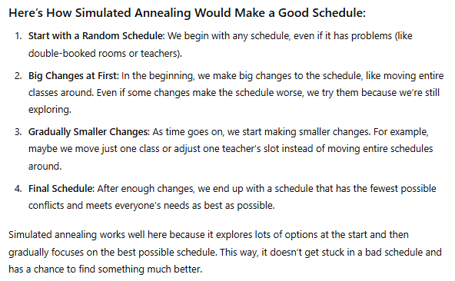
Simulated Annealing

Slide 20

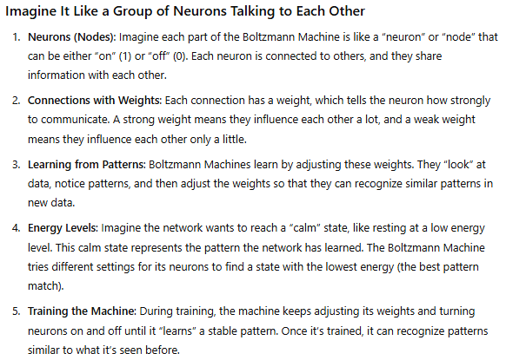
Boltzmann Machine

Slide 21
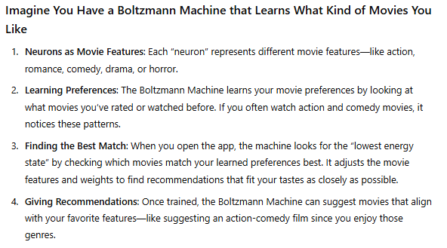

Slide 22
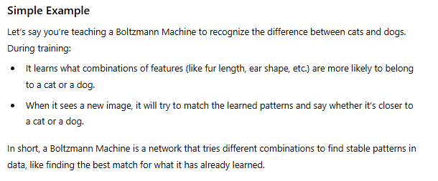

Slide 23
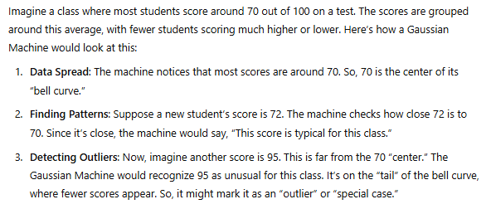
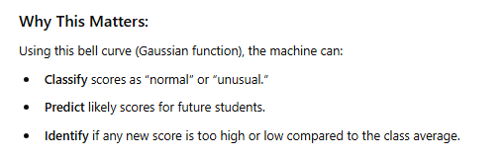
Gauusian machine

Slide 24
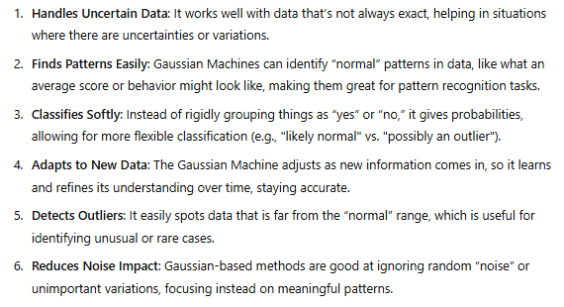
Advantages of Guassian Machine:-

Slide 25
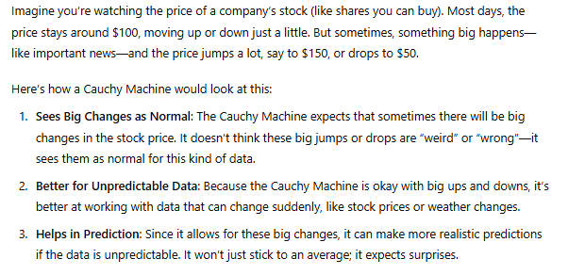

Cauchy Machine

Slide 26
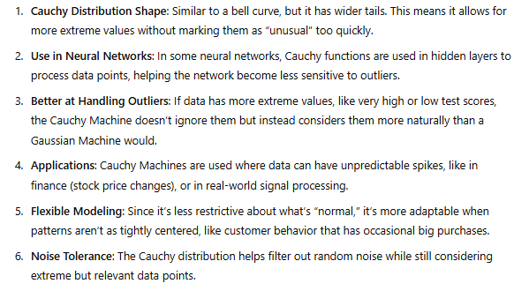

Slide 27

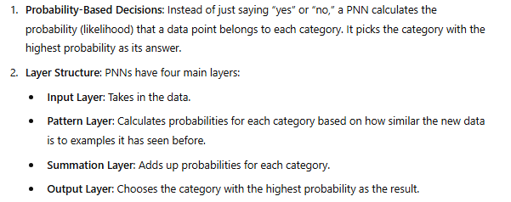
Probabilistic Neural Network (PNN)

Slide 28
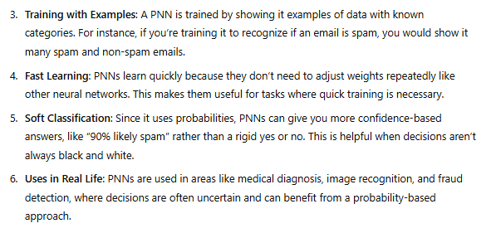

Slide 29

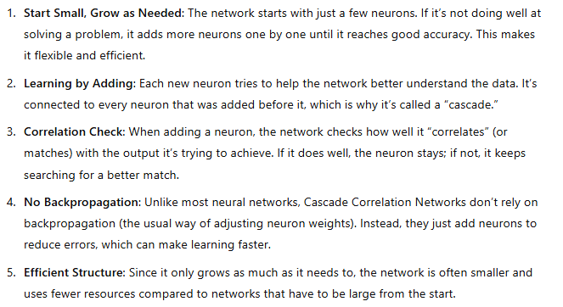

Cascade Correlation Network

Slide 30
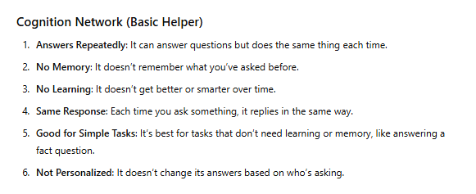
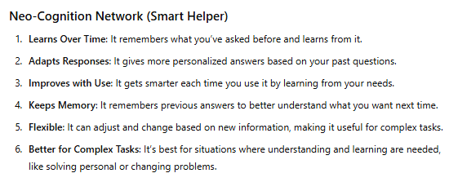
Cognition Network & Neo-Cognition Network (NCN)

Slide 31

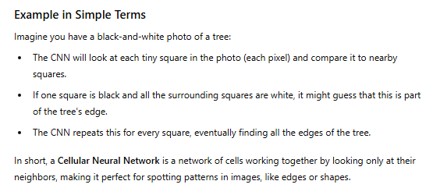
Cellular Neural Network (CNN)

Slide 32
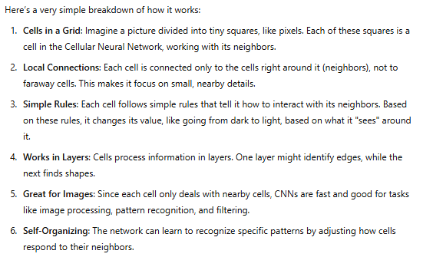

Slide 33
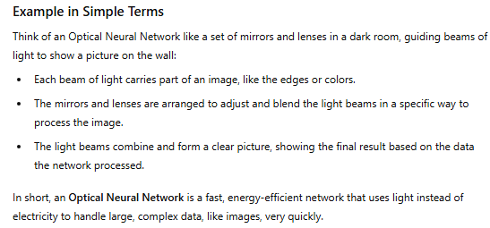
Optical Neural Network (ONN)

Slide 34
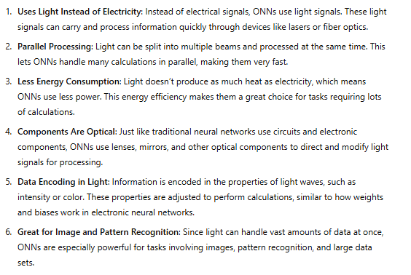

Slide 35
Third generation neural network
Third-generation neural networks are called spiking neural networks (SNNs).
In regular neural networks, data is processed as fixed patterns, like steady signals. But in SNNs, the "neurons" send quick bursts of energy (or "spikes") at certain times. This is similar to how neurons in our brains send electrical signals.

Slide 36
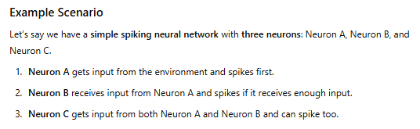
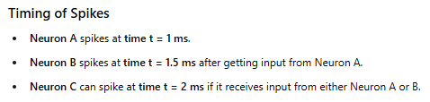
Workflow of SNNs:-

Slide 37
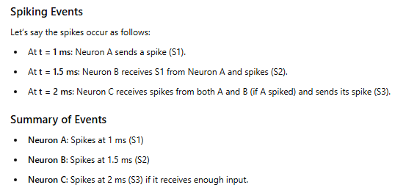


Slide 38
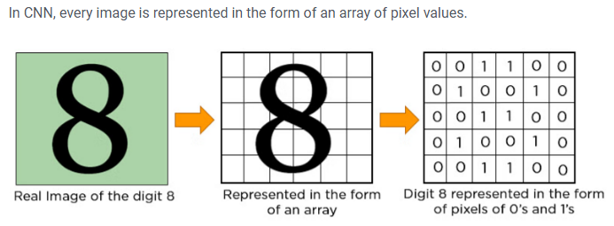
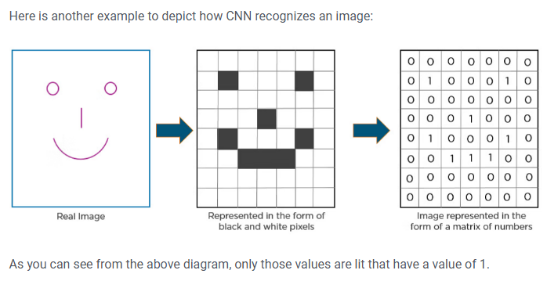
Convolutional Neural Networks (CNNs)

Slide 39
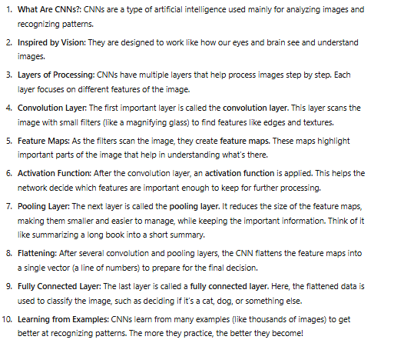

Slide 40
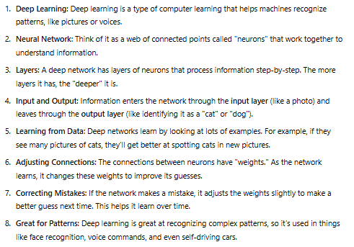
Deep Learning Neural Networks

Slide 41

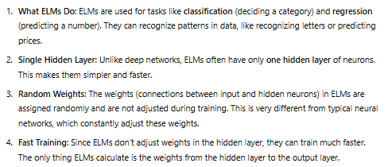

Extreme Learning Machine Model (ELM)

